Slide 1

MATLAB Matrices: Get Access to Elements in a Matrix
Professor Bo Liu
James Watt School of Engineering

Slide 2
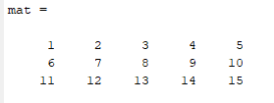
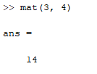
Get access to an element
Matrix indexing means to access a specific element or (a) set(s) of elements from a given matrix.
To index into a matrix, specify the desired row and column position in parentheses.
Example: retrieve the element located in row 3 of column 4.
See live script

Slide 3


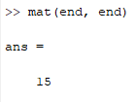
Index of the first and last element
The index of the first element in any row or column is “1”.
The index of the last element in any row or column is “end”.
See live script

Slide 4



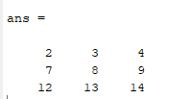
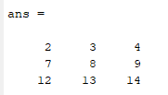
The colon operator
The colon operator can be used to get access to multiple elements in a from:to fashion.
Omitting both from and to will replace them with 1 and end respectively.
See live script

Slide 5




Thanks!
#UofGWorldChangers
@UofGlasgow

